Slide 2
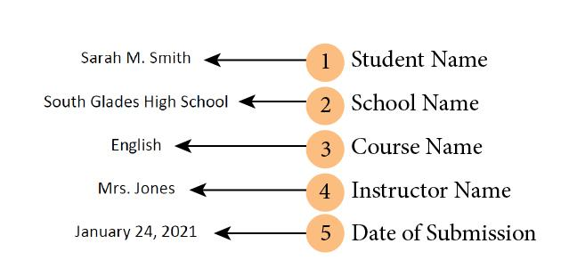
First name Last name
School’s name
Course name
Teacher’s name (use formal or professional titles, i.e. Mrs., Mr., Dr.)
Date
Notes:
The student title page includes the paper title, author names (the byline), author affiliation, course number and name for which the paper is being submitted, instructor name, assignment due date, and page number, as shown in this example.
Student papers do not include a running head unless requested by the instructor or institution.

Slide 3
Page numbers beginning with #1
Title describing essay content, not the assignment. Bold.
2 Double spaces
Heading containing
Student’s name
School’s name
Course
Teacher’s name
Date
Notes:
A variety of fonts are permitted in APA Style papers. Font options include the following:
sans serif fonts such as 11-point Calibri, 11-point Arial, or 10-point Lucida Sans Unicode
serif fonts such as 12-point Times New Roman, 11-point Georgia, or normal (10-point) Computer Modern (the default font for LaTeX)
We recommend these fonts because they are legible and widely available and because they include special characters such as math symbols and Greek letters. Historically, sans serif fonts have been preferred for online works and serif fonts for print works; however, modern screen resolutions can typically accommodate either type of font, and people who use assistive technologies can adjust font settings to their preferences. For more on how font relates to accessibility, visit the page on the accessibility of APA Style.

Slide 4
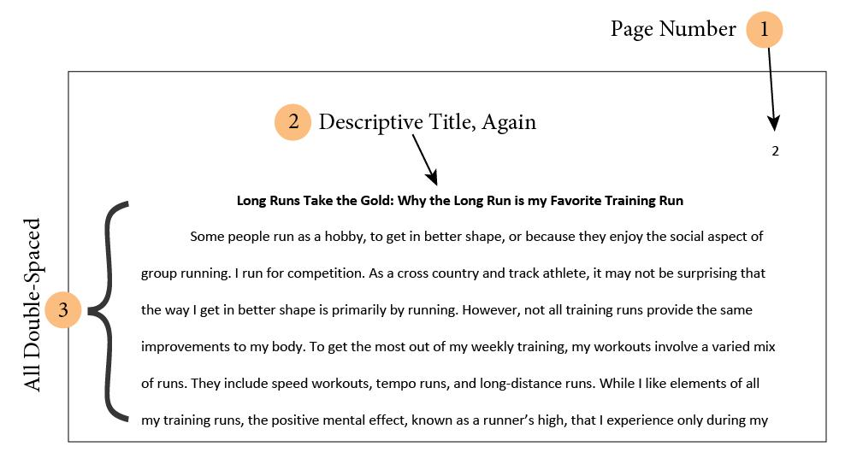
Page numbers
Title describes the content, not the assignment. Bold.
All lines are double-spaced

Slide 5
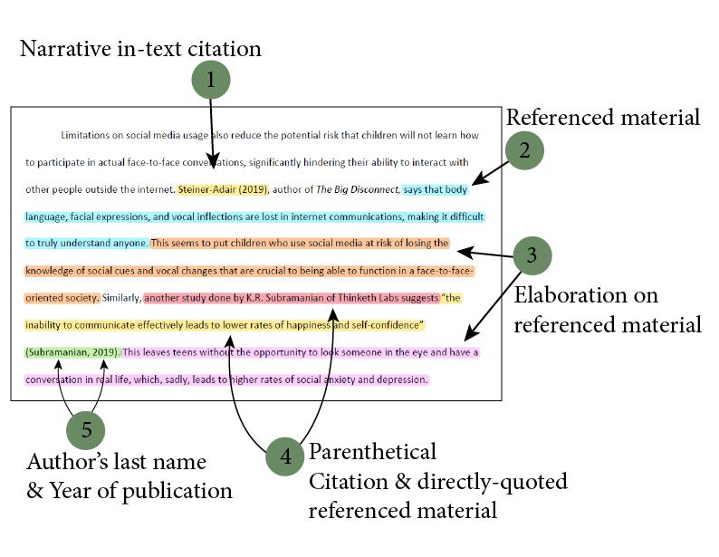
A Narrative citation
Relevant material from source
Your own elaboration. How is the referenced material relevant to your work?
A Parenthetical citation with a direct quote
In-text citation for a parenthetical citation
Notes:
APA Style uses the author–date citation system, in which a brief in-text citation directs readers to a full reference list entry. The in-text citation appears within the body of the paper (or in a table, figure, footnote, or appendix) and briefly identifies the cited work by its author and date of publication. This enables readers to locate the corresponding entry in the alphabetical reference list at the end of the paper.
Each work cited must appear in the reference list, and each work in the reference list must be cited in the text (or in a table, figure, footnote, or appendix).
Both paraphrases and quotations require citations.
The following are guidelines to follow when writing in-text citations:
Ensure that the spelling of author names and the publication dates in reference list entries match those in the corresponding in-text citations.
Cite only works that you have read and ideas that you have incorporated into your writing. The works you cite may provide key background information, support or dispute your thesis, or offer critical definitions and data.
Readers may find a long string of citations difficult to understand, especially if they are using assistive technology such as a screen reader; therefore, include only those citations needed to support your immediate point.
Cite primary sources when possible, and cite secondary sources sparingly.
Cite sources to document all facts and figures that you mention that are not common knowledge.
To cite a specific part of a source, provide an author–date citation for the work plus information about the specific part.
Even when sources cannot be retrieved (e.g., because they are personal communications), still credit them in the text (however, avoid using online sources that are no longer recoverable).

Slide 6
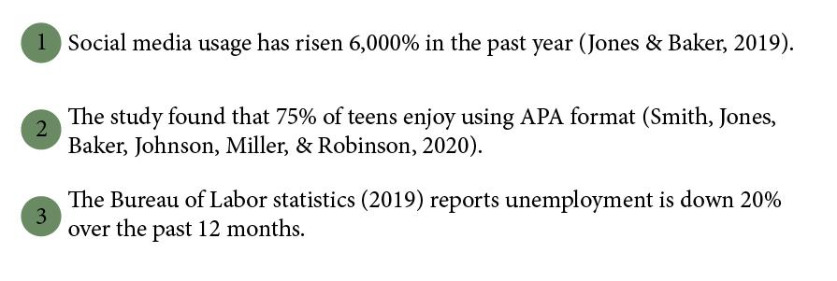
For works with multiple authors, use “Last name & Last name, Year” format.
For works with more than 2 authors, list all authors separated by commas. Use an ampersand (&) before the final name.
For websites with no known author, use the main site, institution, or government agency name
Notes:
Appropriate Level of Citation
The number of sources you cite in your paper depends on the purpose of your work. For most papers, cite one or two of the most representative sources for each key point. Literature review papers, however, typically include a more exhaustive list of references.
Provide appropriate credit to the source (e.g., by using an in-text citation) whenever you do the following:
paraphrase (i.e., state in your own words) the ideas of others
directly quote the words of others
refer to data or data sets
Avoid both undercitation and overcitation. Undercitation can lead to plagiarism and/or self-plagiarism. Overcitation can be distracting and is unnecessary.
For example, it is considered overcitation to repeat the same citation in every sentence when the source and topic have not changed. Instead, when paraphrasing a key point in more than one sentence within a paragraph, cite the source in the first sentence in which it is relevant and do not repeat the citation in subsequent sentences as long as the source remains clear and unchanged.

Slide 7
When do you need to cite your source? When the information is NOT “common knowledge.” If it is common knowledge, no citation is needed
If the information you include is not “common knowledge,” its source must be cited.
Notes:
Paraphrasing
A paraphrase restates another’s idea (or your own previously published idea) in your own words. Paraphrasing allows you to summarize and synthesize information from one or more sources, focus on significant information, and compare and contrast relevant details.
Published authors paraphrase their sources most of the time, rather than directly quoting the sources; student authors should emulate this practice by paraphrasing more than directly quoting.
When you paraphrase, cite the original work using either the narrative or parenthetical citation format.
Although it is not required to provide a page or paragraph number in the citation, you may include one (in addition to the author and year) when it would help interested readers locate the relevant passage within a long or complex work (e.g., a book).
Quotations
A direct quotation reproduces words verbatim from another work or from your own previously published work. It is best to paraphrase sources rather than directly quoting them because paraphrasing allows you to fit material to the context of your paper and writing style.
Use direct quotations rather than paraphrasing:
when reproducing an exact definition (see Section 6.22 of the Publication Manual),
when an author has said something memorably or succinctly, or
when you want to respond to exact wording (e.g., something someone said).

Slide 8
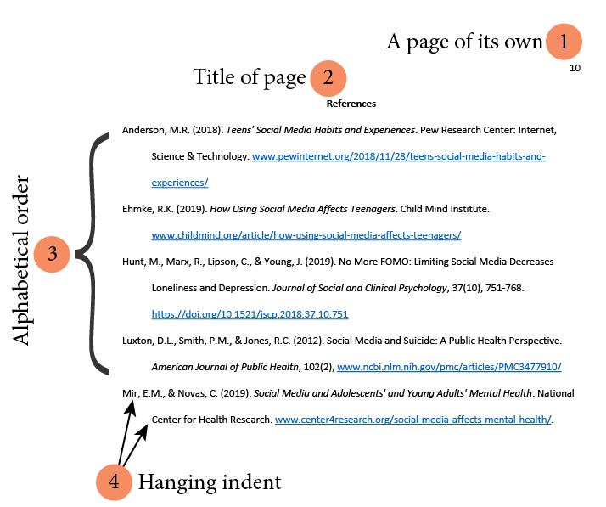
References page always begins on a new page
Title the page “References”
List citations in alphabetical order by authors’ last names
Multi-line entries use hanging indents
Notes:
Basic Principles of Reference List Entries
A reference list entry generally has four elements: the author, date, title, and source. Each element answers a question:
author: Who is responsible for this work?
date: When was this work published?
title: What is this work called?
source: Where can I retrieve this work?
Answering these four questions will help you create a reference entry for any type of work, even if you do not see a specific example in the Publication Manual that matches it. Consistency in reference formatting allows readers to understand the types of works you consulted and the important reference elements with ease.

Slide 9
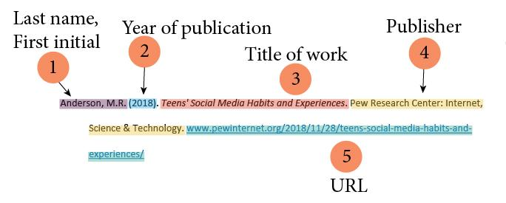
List authors in “Last name, First initial(s)” format
Year of publication in parentheses
Title of the work
Publisher of the work
URL if accessed online
Notes:
Works Included in a Reference List
The reference list provides a reliable way for readers to identify and locate the works cited in a paper. APA Style papers generally include reference lists, not bibliographies.
In general, each work cited in the text must appear in the reference list, and each work in the reference list must be cited in the text. Check your work carefully before submitting your manuscript or course assignment to ensure no works cited in the text are missing from the reference list and vice versa, with only the following exceptions.
Works excluded from a reference list
There are a few kinds of works that are not included in a reference list. Usually a work is not included because readers cannot recover it or because the mention is so broad that readers do not need a reference list entry to understand the use.
Personal communications such as emails, phone calls, or text messages are cited in the text only, not in the reference list, because readers cannot retrieve personal communications.
General mentions of whole websites, whole periodicals, and common software and apps in the text do not require in-text citations or reference list entries because the use is broad and the source is familiar.
The source of an epigraph does not usually appear in the reference list unless the work is a scholarly book or journal. For example, if you open the paper with an inspirational quotation by a famous person, the source of the quotation does not appear in the reference list because the quotation is meant to set the stage for the work, not substantiate a key point.
Quotations from research participants in a study you conducted can be presented and discussed in the text but do not need citations or reference list entries. Citations and reference list entries are not necessary because the quotations are part of your original research. They could also compromise participants’ confidentiality, which is an ethical violation.
References included in a meta-analysis, which are marked with an asterisk in the reference list, may be cited in the text (or not) at the author’s discretion. This exception is relevant only to authors who are conducting a meta-analysis.

Slide 11
Notes:
This slide is intentionally blank. You may use this for whatever you like.

Slide 12
Notes:
This slide is intentionally blank. You may use this for whatever you like.

Slide 13
Notes:
This slide is intentionally blank. You may use this for whatever you like.

Slide 14
Notes:
This slide is intentionally blank. You may use this for whatever you like.

